Slide 1
Unified Modelling Language
Foundations of Software Development and Software Testing
2022/23

Slide 2
UML / Structure
1
Package diagram
2
Component diagram
3
Class diagram
4
Object diagram
5
Composite structure diagram
6
Deployment diagram

Slide 3
UML / Behaviour
1
State machine diagram
2
Use case diagram
3
Activity diagram
4
Timeline diagram
5
Sequence diagram
6
Communication diagram
7
Interaction overview diagram

Slide 4
Tools
-
Lucidchart ($)
-
Draw.io
-
PlantUML
-
Microsoft Visio ($)
-
Etc… https://en.wikipedia.org/wiki/List_of_Unified_Modeling_Language_tools

Slide 5
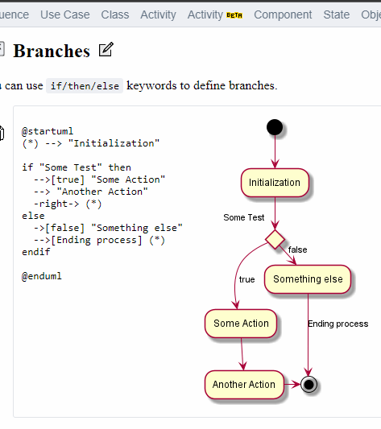
Tool: PlantUML
UML
PlantUML is a component that allows to quickly write:
Sequence diagram
Use case diagram
Class diagram
Object diagram
Activity diagram (here is the legacy syntax)
Component diagram
Deployment diagram
State diagram
Timing diagram

Slide 6
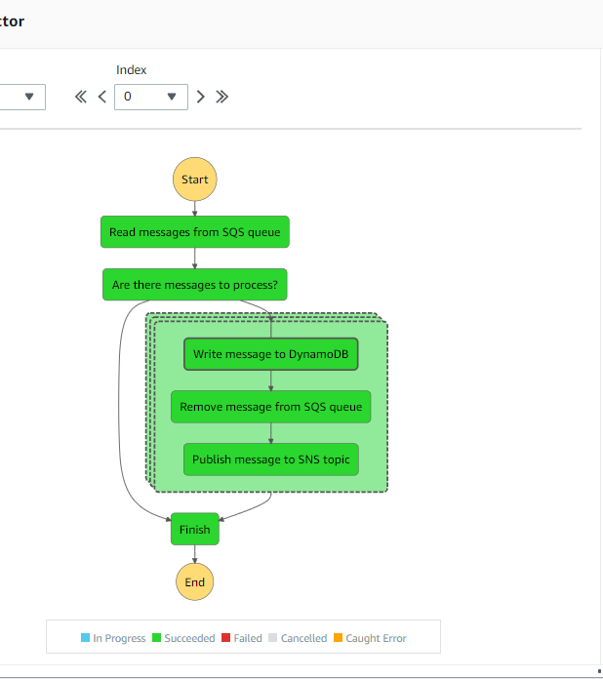
Case: AWS State Machine
UML
A state machine that dynamically iterate a series of steps by passing any array to a Map state (AWS Lambda, Amazon SQS, Amazon SNS, Amazon DynamoDB).
https://eu-central-1.console.aws.amazon.com/states/home?region=eu-central-1#/sampleProjects

Slide 7
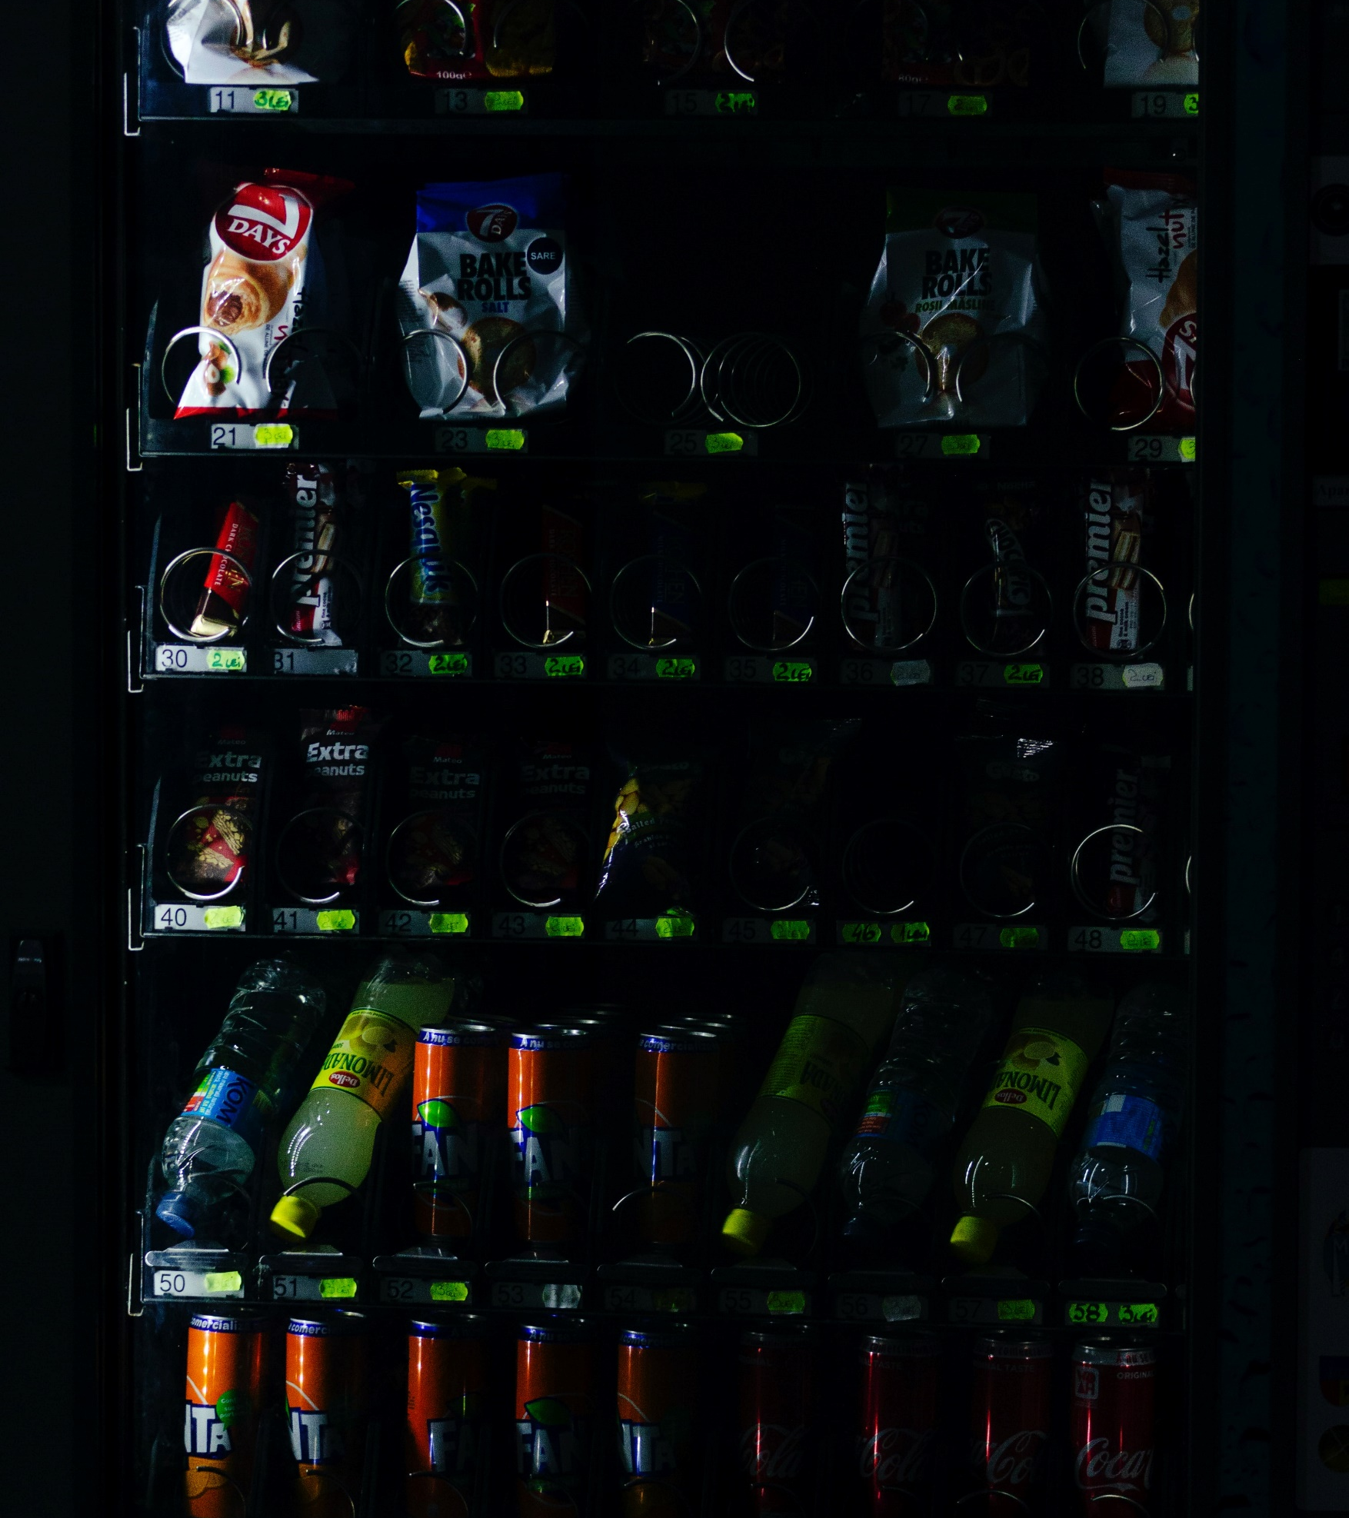
Task 1: Beverage Vending Machine
UML
Create the activity diagram of the behaviour of the beverage vending machine of the ground floor.

Slide 8

Task 2: ATM
UML
Create the activity diagram of an ATM what can be used to withdraw money from your back account.

Slide 9
Questions?

Slide 10
Opportunities as EPAM
CARRIER
Become a mentee!
Become a colleague!
Mentored Education Programs (MEP):
Java Test Automation
JavaScript Test Automation
Python Test Automation
Java Developer
DevOps Academy
Front End Online Training
Development / JavaScript​
Development / Java​
Systems Engineer / Core DevOps​
Systems Engineer / Cloud AWS​
Systems Engineer / Cloud Azure​
Systems Engineer / Cloud GCP
Testing / Software Testing Engineer​
Testing / Software Quality Engineer​
SET / Software Test Automation Engineer​
SET / Software Engineer in Test
…
Contact: ​ WFATalentAcquisitionDebrecen@epam.com ​
https://careers.epam.com​

Slide 11
Thank you!
balazs_radocz@epam.com
laszlo_szikszai@epam.com

